Slide 1
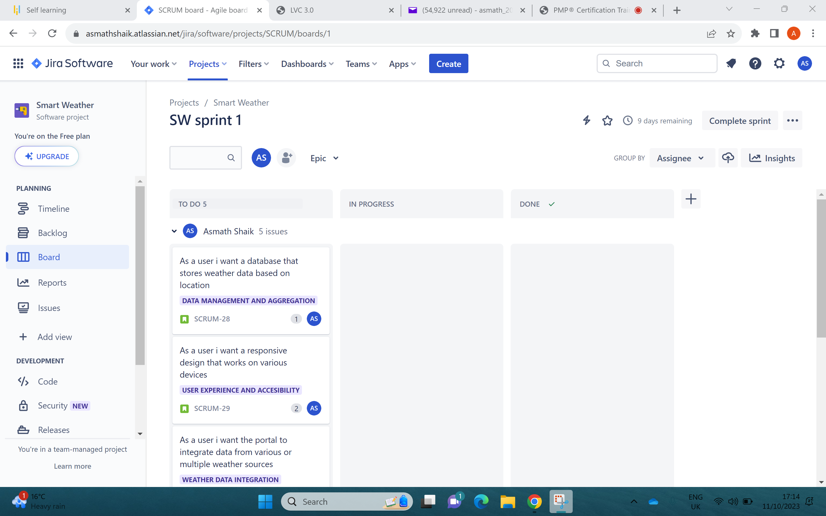
BOARD DISPLAY OF SPRINT WORK

Slide 2
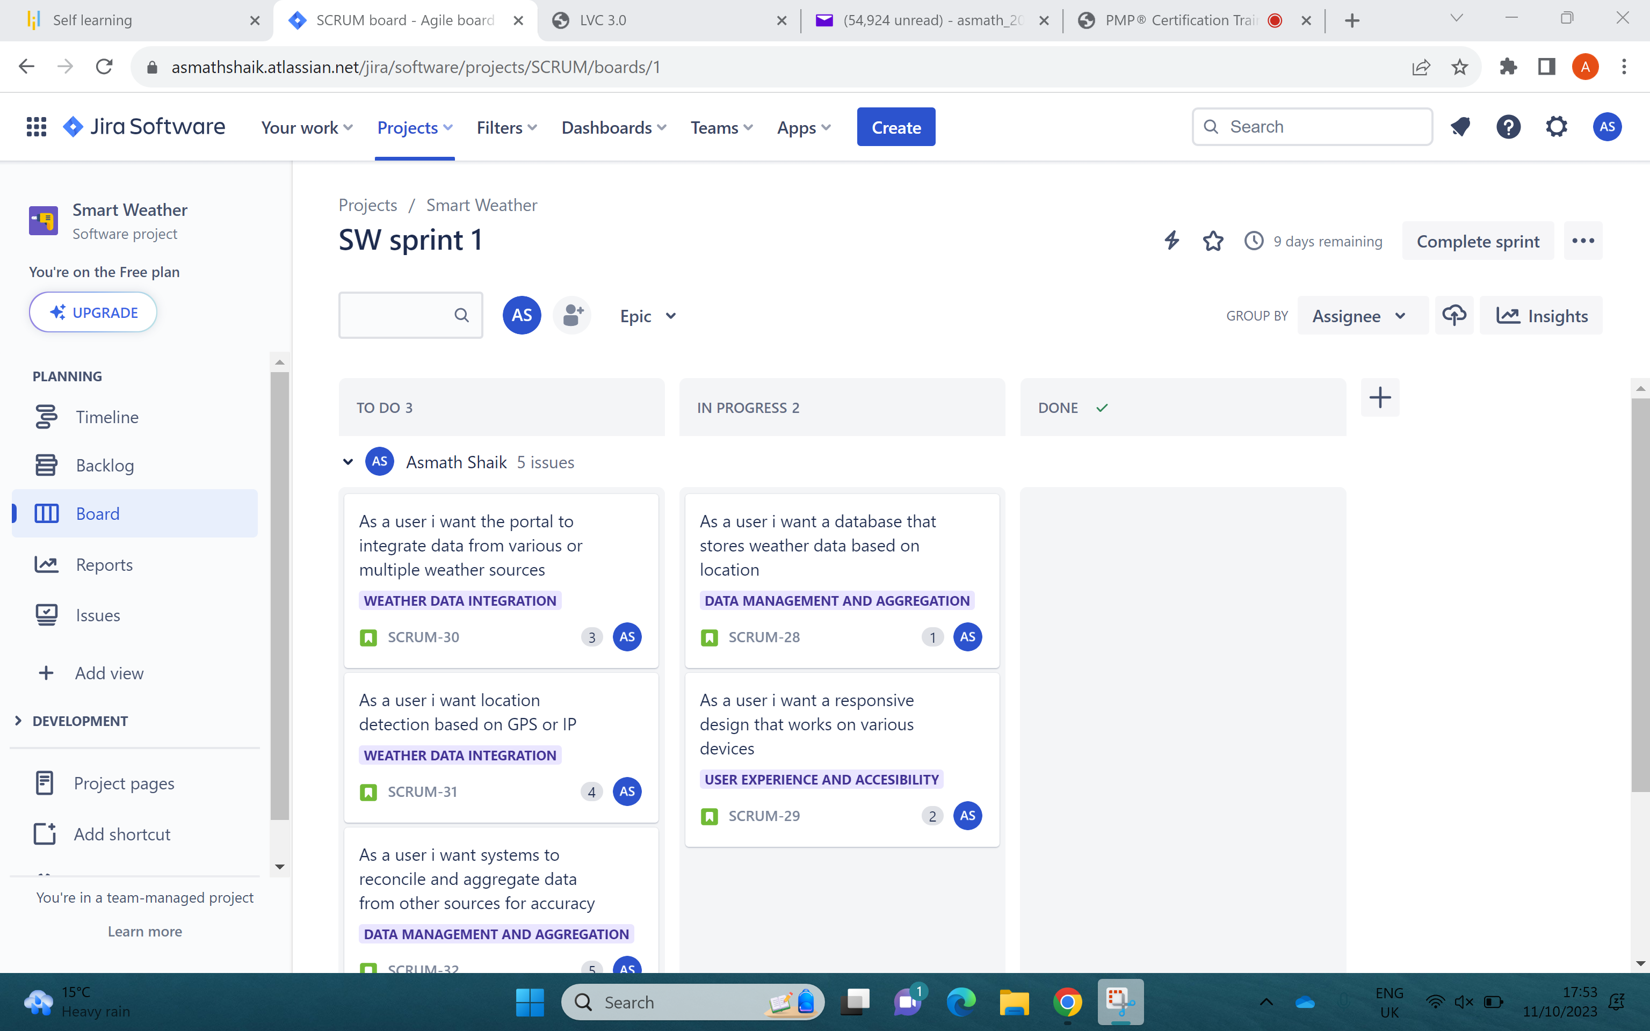
SPRINT WORK IN EXECUTION ONE

Slide 3
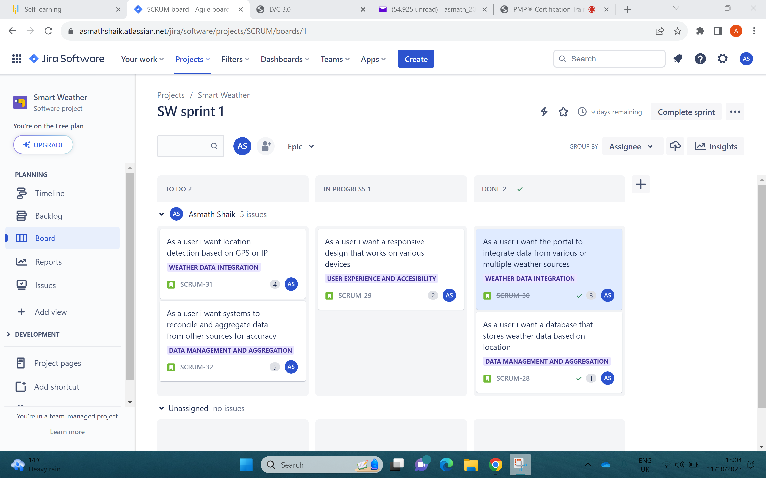
SPRINT WORK IN EXECUTION TWO

Slide 4
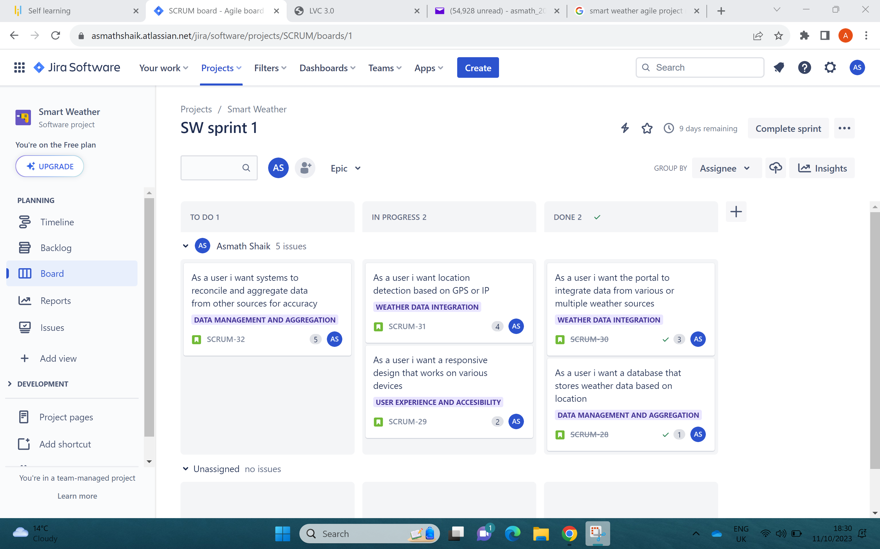
SPRINT WORK IN EXECUTION THREE

Slide 5
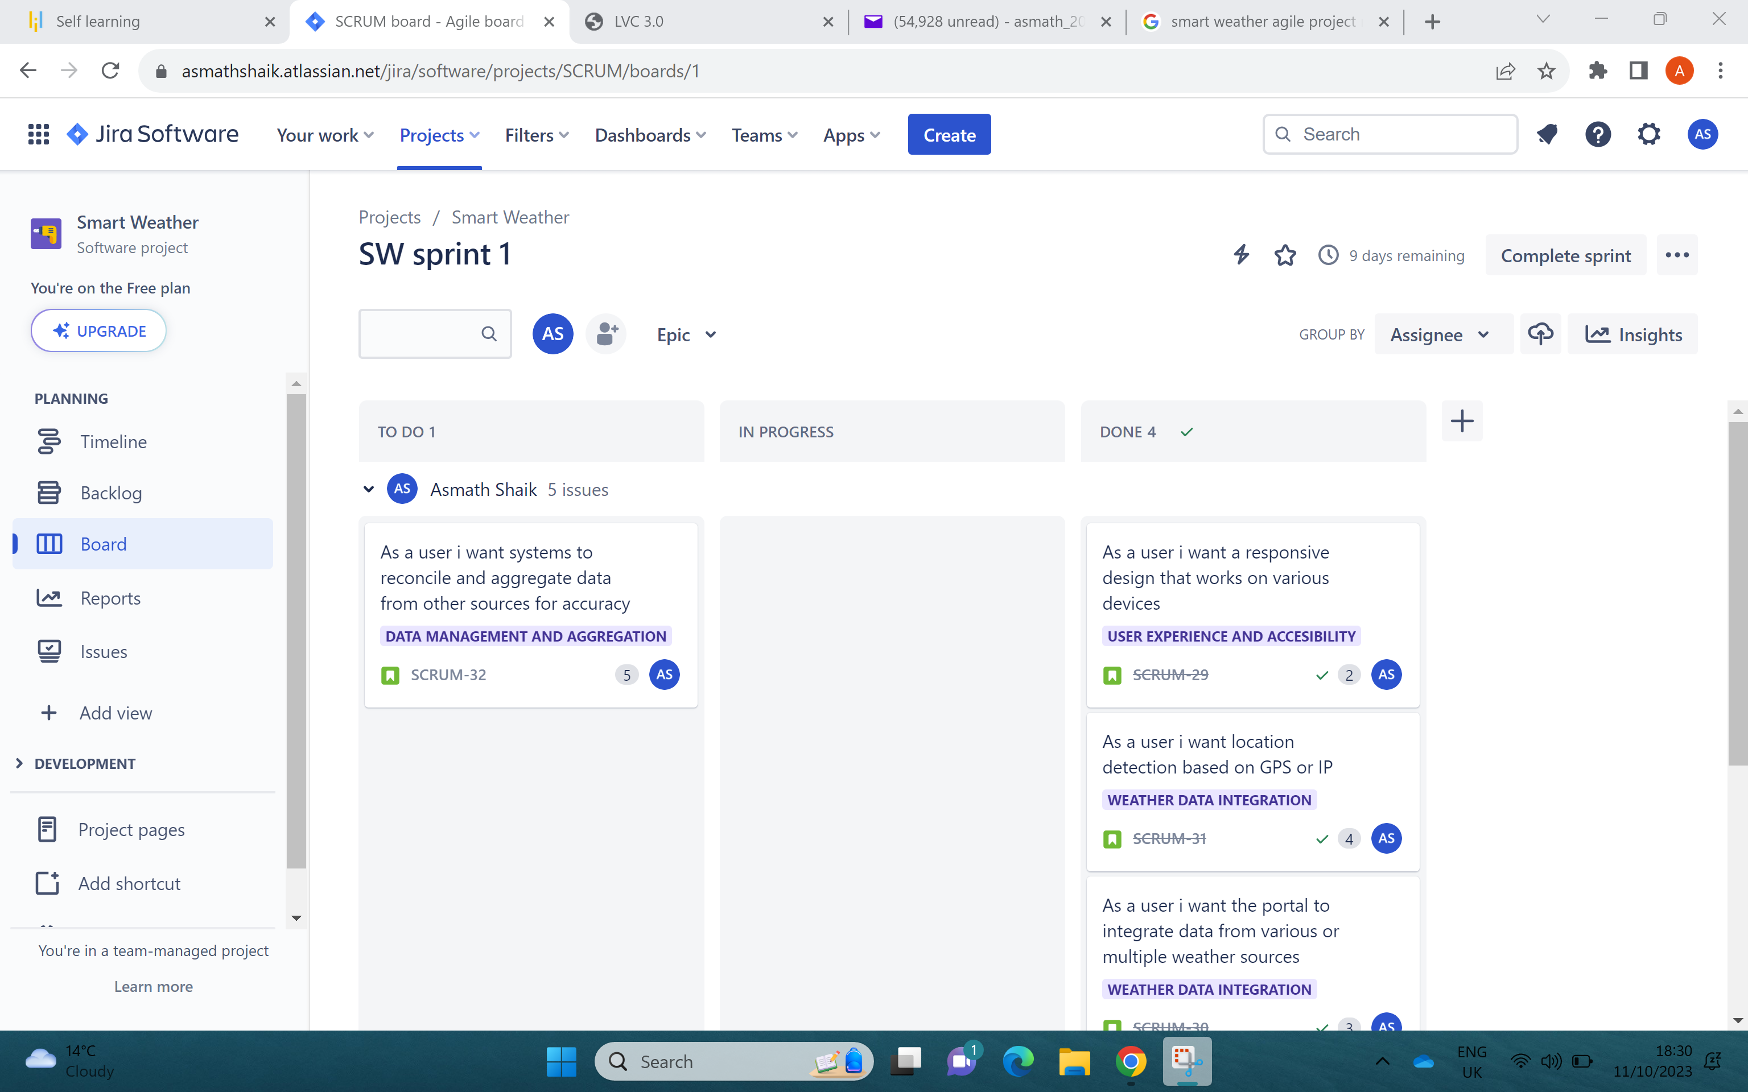
SPRINT WORK IN EXECUTION FOUR

